Slide 1

Understanding Institutional Effectiveness & Assessment @ B-CU
Jennifer Dash
Director of Institutional Assessment and Evaluation
Dorian Hooks
Institutional Assessment Coordinator
Academic Programs

Slide 2

Building Capacity
Capacity: Our ability to seek solutions to our challenges so that we can achieve our goals and objectives.
Capacity building: Should provide faculty and staff the skills and tools needed (state proper outcomes, identify assessments – direct and indirect, collection of data, analysis of data, use of data to drive improvement) and strengthen our ability to work together..
Creating the common vision through multiple perspectives that matches Dr. Jackson’s vision

Slide 3
Framework for Institutional Effectiveness
Purpose
Goals
Components of IE
Accountability

Slide 4
Institutional Effectiveness
Purpose:
To systematically engage in a process designed to monitor and document the degree to which the institution is progressing together towards accomplishing its Mission.
Annual IE Report
Accreditation Reports
Annual Assessment Report

Slide 5
IE Goals
Inform the strategic planning process
Promote effective allocation of resources (human & fiscal)
Engage faculty and staff in the continuous improvement of the institution’s programs and services
Provide accountability to stakeholders

Slide 6
Components of IE
Planning (Mission-driven – plan and review mission simultaneously, integrated into the annual planning and budgeting cycle)
Budgeting (driven by Mission and Division plans)
Assessment
Academic Program Assessment
Administrative & Educational Support Services Assessment
General Education Assessment
University Assessment
Feedback Mechanism / Accountability Annual Reports
(University, Division, Unit)
Annual IE report
Annual assessment report
Accreditation reports
How is the IE process Organized and Coordinated? (Institutional Research, Fiscal, Assessment, IE)
How is the IE process supported? (leadership support, IT, faculty and staff development, policies and procedures manual, reporting templates)

Slide 7
Accountability
Who is the audience? (Who is responsible?)
What are the products? (IE report, Assessment report, Accreditation reports)
How do we most effectively communicate (convey information) to stakeholders?
What is the process for getting a good product?
.

Slide 8
The Art of Explanation
“The single biggest problem in communication is the illusion that it’s taken place.”
G. Bernard Shaw
Source: Keynote Speech AIR Forum Orlando, May 2014, Lee LeFever, Common Craft

Slide 9
A Culture of Evidence
“Accrediting agencies – both at the institutional level and the programmatic level – are now operating in a ‘culture of evidence’ that requires institutions to qualitatively and quantitatively demonstrate that they are meeting student learning goals and effectively marshalling human and fiscal resources toward that end.”
Michael Middaugh
Author of Planning and Assessment in Higher Education

Slide 10

Assessment Transparency
Student
Learning Outcome Statements
Specific
Assessment
Plans
Descriptive
Defines Measures
Easy to download
Use of Student
Learning Evidence
Targeted to audience
Provides examples
Describes improvement
Defines next steps
COMMON TO ALL
Clearly worded
Prominently posted
Updated regularly
Receptive to feedback
Assessment
Resources
Easy to download
Evidence of
Student Learning
Interpreted results
Contextualized to B-CU
Presented graphically
Disseminated
Current Assessment Activities
Defines activities
Source: National Institute for Learning Outcomes Assessment (NILOA)

Slide 11
Faculty Mindset
No program is so unique that its students are not going to compete with others locally, nationally, and around the globe. Students must learn what is necessary to compete, and it’s our job to assess that they are learning and contending with all graduates.
Our assessment data tells the story that our students are competitive and ready to move to the next level!

Slide 12
Assessment @ B-CU
Assessment is an integral part of the annual planning activities at B-CU, as it determines whether or not the objectives of education are being met. The main goals in the assessment of student learning are:
Document what learning is taking place and
Utilize the results of assessment activities to improve student learning

Slide 13
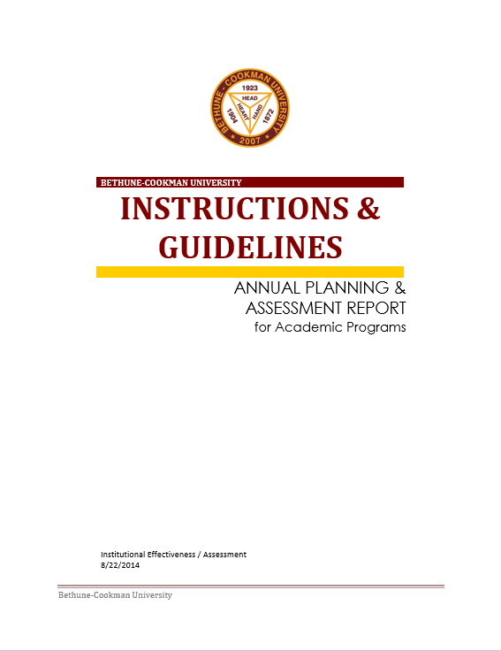

Annual Planning & Assessment Report
Guide
Template

Slide 14
Annual Planning and Budgeting Cycle
Analyze data and recommend improvements
Review / revise Annual Plans
VP, Deans, Department Chairs and Directors submit Annual Report for the upcoming academic year.
Collect, aggregate, disaggregate, and share data
B-CU collects assessment data to enhance student learning outcomes in an ongoing, faculty-driven continuous improvement cycle by adhering to an assessment plan.
Aug-Oct
May - Aug
October
The deadline for the Annual Planning and Assessment Report
for the 2024-25 academic year is
June 2025.

Slide 15
Elements of the Report
Description of the Program
Mission Statement of the Program
Program Student Learning Outcomes
Curriculum Map (IRMA)
Assessment Map
Annual Planning and Assessment Grid
Assessment Plan Methods and Procedures
Rubric for Assessing the Annual Assessment Report
Program Data Collection

Slide 16
Description of the Program
In this section, provide a brief overview of your program. Oftentimes, this description can be taken from the program’s description in the Academic catalog for the current year.

Slide 17
Mission
Remember that the mission of the program must be aligned with the Mission of the University and demonstrate that it supports the Mission of the University.
“The mission of Bethune-Cookman University is to educate a diverse community of learners to become responsible, productive citizens and solution seekers through the promotion of faith, scholarship, creative endeavors, leadership and service.”
(Revised and approved by the Bethune-Cookman University Board of Trustees, January 17, 2020)

Slide 18
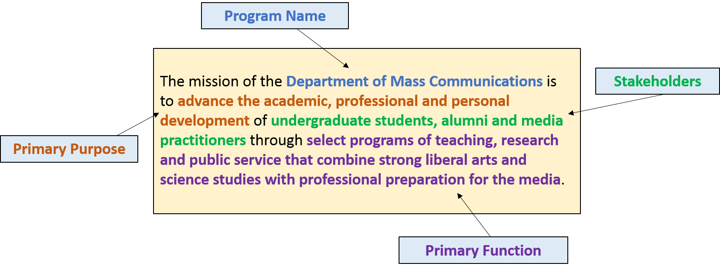
Mission

Slide 19
Program Student Learning Outcomes
While some refinement of PSLOs is warranted from year to year, the purpose is to clearly identify your current program PSLOs rather than to develop a revised set of PSLOs.
Programs will also complete a periodic Program and Curriculum Review to ensure relevance, timeliness, and program rigor where the need for new PSLOs will arise.

Slide 20
Curriculum Map
Map where each PSLO will be assessed in the curriculum.
Key: It is typical to use multiple courses (two to three) to assess a PSLO.

Slide 21
Curriculum Map
Program Curriculum Map
Program Name_______________________________________________________________________
 | Course 1 | Course 2 | Course 3 | Course 4 | Course 5 | Course 6 | Course 7
PSLO 1
PSLO 2
PSLO 3
PSLO 4

Slide 22
Curriculum Map
Your program has a complete IRMA chart that aligns ISLOs, School Learning Outcomes (where applicable), PSLOs, and CSLOs. The curriculum map for the Annual Planning and Assessment Report is different from your complete IRMA chart.
On the chart for this report, list the two or three primary courses where programmatic assessment of the student learning outcomes takes place in the curriculum.

Slide 23
Curriculum Map Designations
I = Introduced. An “I” indicates that the students are being introduced to the outcome and the course covers material related to the PSLO.
Best practice = Students introduced to all PSLOs early in the program and then be given sufficient opportunities to practice and be reinforced through a formative process before an assessment of their final level of mastery occurs.
R = Reinforced. An “R” indicates that the outcome will be reinforced in the course, and the students are given ample opportunities to learn and practices.

Slide 24
Curriculum Map Designations
M = Mastered. An “M” indicates that in the course students will be expected demonstrate mastery of the outcome.
A = Assessed. An “A” indicates where evidence and data will be collected for assessment purposes.

Slide 25
Curriculum Map Example
 | MAT 095 - Beginning Algebra | MAT 131-Mathematics for Liberal Arts | MAT 332 - Advanced Calculus | MAT 334 - Differential Equations | MAT 437 - Complex Variables I | MAT 498 - Senior Seminar I | MAT 499 - Senior Seminar II
PSLO 1 | I | IA | RA |  |  | MA
PSLO 2 | IA | RA |  |  | MA |  | MA
PSLO 3 | I | RA |  |  | MA |  | MA
PSLO 4 |  |  |  | IA |  | RA | MA

Slide 26
Assessment Map
Complete the Program Assessment Map using the grid provided by entering at least two assessments for each PSLO (the same assessment can be used for more than one PLSO). Explicitly state the following:
Whether the assessment you are using is a direct measure or an indirect measure
Course in which the assessment will be completed (e.g. BI 131). If post-graduation, simply state it.

Slide 27
Direct vs. Indirect Measures
Method | Direct | Indirect | Method | Direct | Indirect
Exit and Other Interviews |  |  | Locally Developed Written Exams (and Exam Questions)
Simulations |  |  | External Examiner
Behavioral Observations |  |  | Written Surveys Questionnaires
Archival Data |  |  | Portfolios
Capstone Projects, Senior Theses |  |  | Oral Exams
Artifact/Reflection |  |  | Focus Groups
Written Work, Presentations, Performances, Scored on a Rubric |  |  | Course Grades and Grade Distributions
Job / Grad School Placement |  |  | Pass Rates or Scores on Licensure Tests
Performance Appraisal |  |  | Standardized Exams

Slide 28
Assessment Map
Program Assessment Map
Program Name_________________________________________________________________________
 | Assessment 1 | Assessment 2 | Assessment 3 | Assessment 4 | Assessment 5 | Assessment 6 | Assessment 7
PSLO 1
PSLO 2
PSLO 3
PSLO 4

Slide 29
Annual Planning & Assessment Grid
Purposes:
Show the summation and results of data analysis
Tie the assessment plan to any identified, targeted strategic goals
Reveal the program’s expected levels of achievement
Report if the targeted level of achievement was met
Explain how your program plans on using the results in terms of actions

Slide 30
Annual Planning & Assessment Grid
Annual Planning and Assessment (Previous Academic Year)
Mission Statement:
Targeted Strategic Goal(s):
Institutional Student Learning Outcome(s) addressed:
Student Learning Outcomes (PSLOs) | Expected Level of Achievement | Measure/Tool | Results | Use of Results (to include analysis and Action Plan) | Met | Not Met
Other Programmatic Outcomes | Expected Level of Achievement | Measure/Tool | Results | Use of Results | Met | Not Met

Slide 31
Annual Planning & Assessment Grid
Annual Planning and Assessment (Current Academic Year)
Mission Statement:
Targeted Strategic Goal(s):
Institutional Student Learning Outcome(s) addressed:
Student Learning Outcomes (PSLOs) | Expected Level of Achievement | Measure/Tool
Other Programmatic Outcomes | Expected Level of Achievement | Measure/Tool

Slide 32
Assessment Plan Methods & Procedures
Describe the methods and procedures used to assess the program. Be sure to use the questions below to thoroughly cover methods and procedures involved in your assessment plan.
Who was/will be involved in the process of reviewing and revising the assessments?
What is the difference between the previous program assessments and the revised assessments?
How will the assessments be collected?
Who will collect the assessments?
When will the assessments be collected?
Who will aggregate and disaggregate the data?
Who will analyze the data?
How are / will data (be) used to drive improvement?
How do you want to share the information with stakeholders?

Slide 33
Program Data Collection
Data Requested | Results |  | Comments
Name of 5 peer institutions used for program comparison | 1
 | 2
 | 3
 | 4
 | 5
Percentage of courses taught by full-time faculty
Percentage of courses taught by part-time faculty

Slide 34
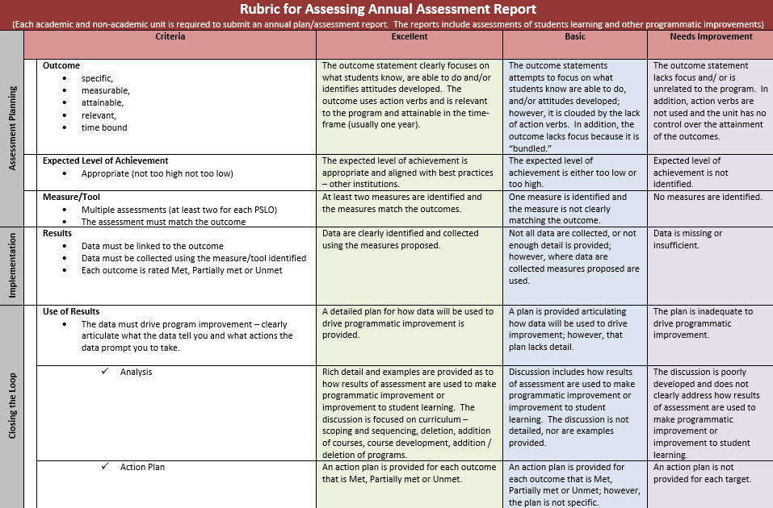

Slide 35

THANK YOU!
For additional information and resources fee free to reach out to the Office of Institutional Effectiveness Directly.

